Slide 1
DigitalKhatt progress and future works
Amine Anane

Slide 2
Plan
DigitalKhatt works on Quran and Arabic typesetting. It is structured around three main axes.
Tools to develop variable fonts
Variable font design
Justification
Progress and future work of the above aspects

Slide 3
Visual MetaFont editor progress
Added Front end justification
Improved collision detection which can now applied to front end justification to detect all the collision
Improved graphically controlled MF expressions and functions
Added documentation showing how to design a new font or improve existing fonts (https://github.com/DigitalKhatt/visualmetafont)
Support of other axes besides leftTatweel and rightTatweel
Support for colored glyph
Less hard coded functionality
Bug fixes

Slide 4
Madina Mushaf analyzer progress
Used to generate the glyph shapes in the design of new Madina font
Helps to infer justification rules
Added new character segmentation and mark detection but still many incorrectly segmented words
if we manage to finish it, we can have
Better kashida and shape analysis
Digital copy of the 1441 Madina Mushaf with Tajweed coloring
Can be generalized to other Mushafs (Warsh, Qaloon, …, https://dm.qurancomplex.gov.sa/downloads/)

Slide 5
Old and new madina fonts
Old Madina font based on Madani Mushaf 1405 Hijri
New Madina font based on Madani Mushaf 1441 Hijri
Less collision and tight glyphs
Better kashida using interpolation
Added new ligatures

Slide 6
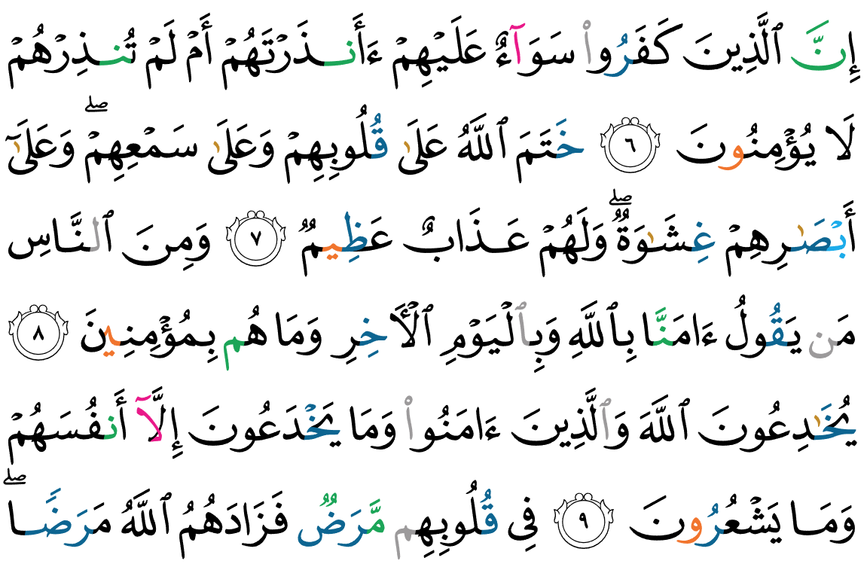
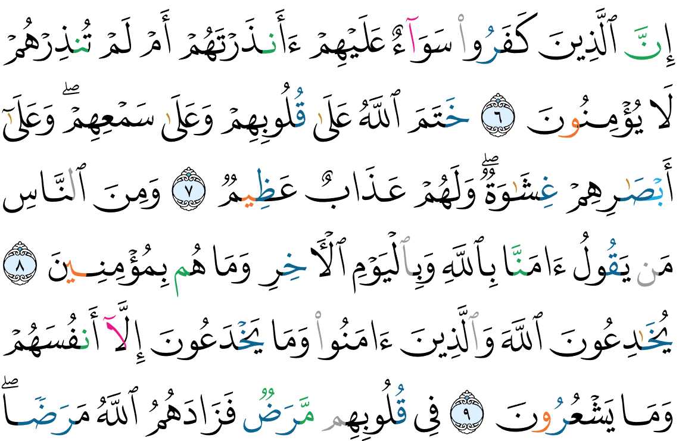
Old and new madina fonts example

Slide 7
Backend Justification https://www.tug.org/TUGboat/tb42-3/tb132anane-variable.pdf
Justification algorithm Implemented in HarfBuzz
Justification rules implemented in the font
Pros
variable glyphs as functions
beh(leftTatweel, rightTatweel, axis3, ..) => glyph with given parameters at runtime
Continuous parameter values
Cons
Justification tightly coupled to the font
Custom library => Needs more work to port and implement

Slide 8
Frontend Justification
Justification Implemented in the frontend using regexprs and Opentype features
Pros
The user of the font has more control on justification
more accessible to study and implement different justification strategies
Supported already by HarfBuzz
Cons
Discrete values : one glyph for each parameter combination
Less performant
Demos
https://digitalkhatt.org/hb/newmedina
https://digitalkhatt.org/hb/oldmedina

Slide 9
Future works
Complete Tajweed rules and coloring
Improve fonts
Adjust spacing
Add other ligatures
Add other quiraats and rasms
Improve Justification
Add other justification rules
better manage tight lines

Slide 10
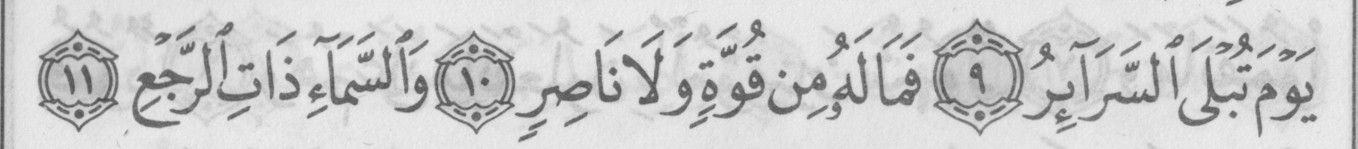
How to deal with tight lines

Slide 11
How to deal with tight lines
Two immediate solutions
Change the font size for all the Mushaf : Maximum font size such that no line overflows
Pros : same font size
Cons :
Small font size : could affect readability for small devices
many lines become very loose : excess spacing and/or stretching
Change the font size for each page (current solution) : Maximum font size such that no line of the page overflows
Pros : increase font size for better readability and minimize loose lines Cons : less uniform pages

Slide 12
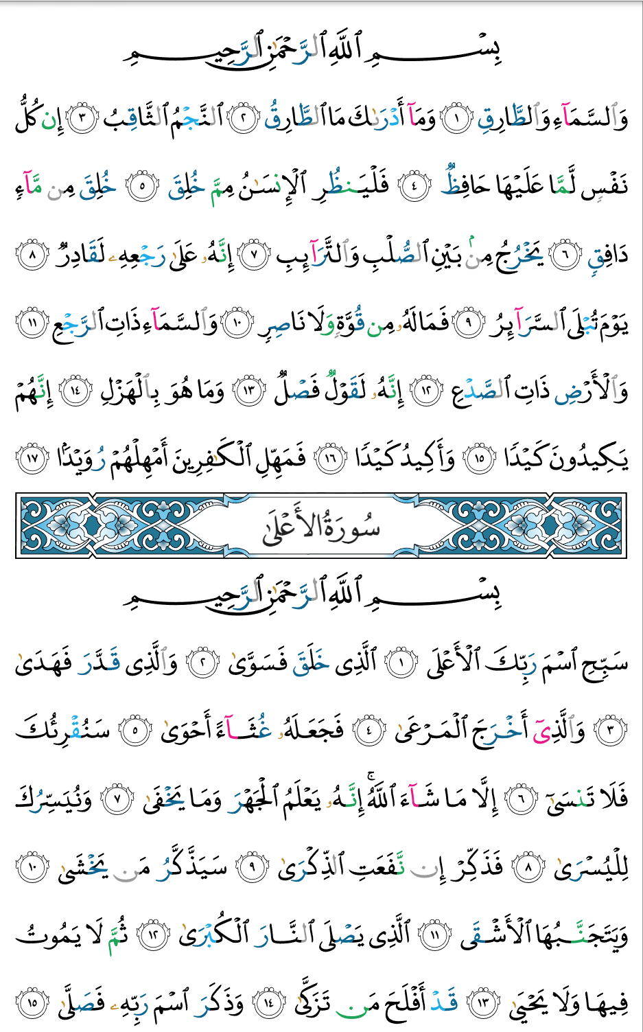
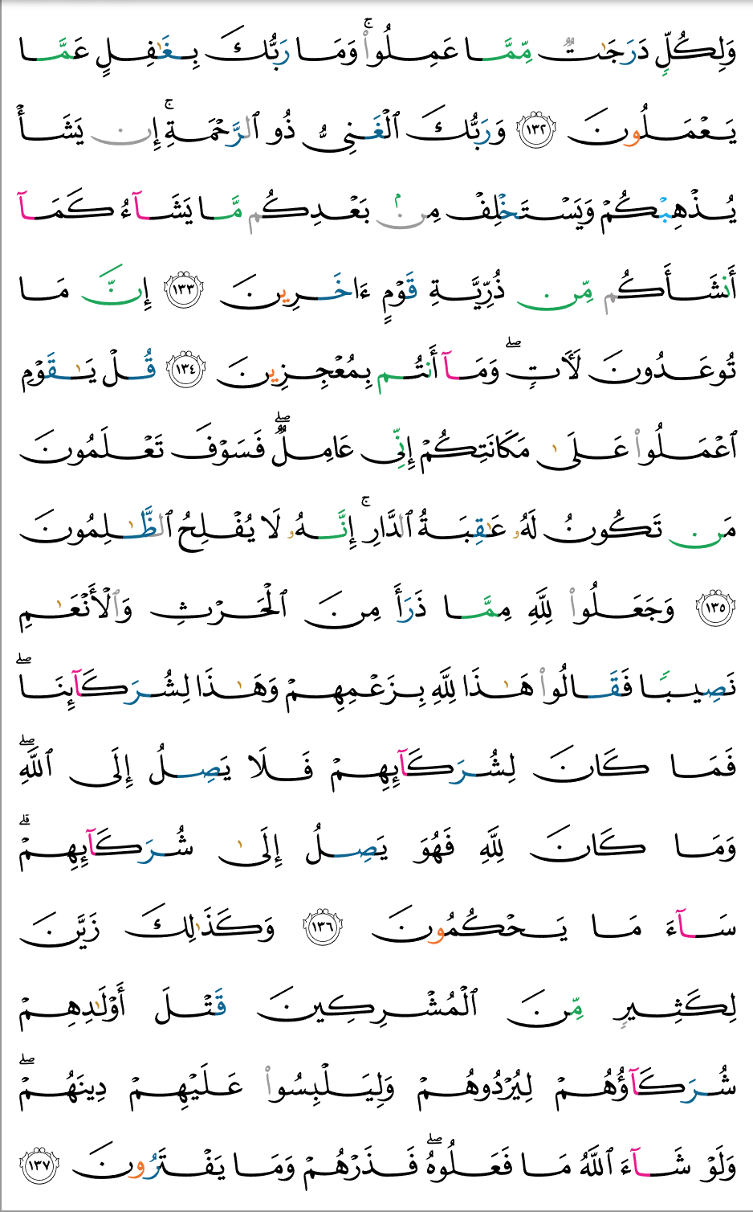
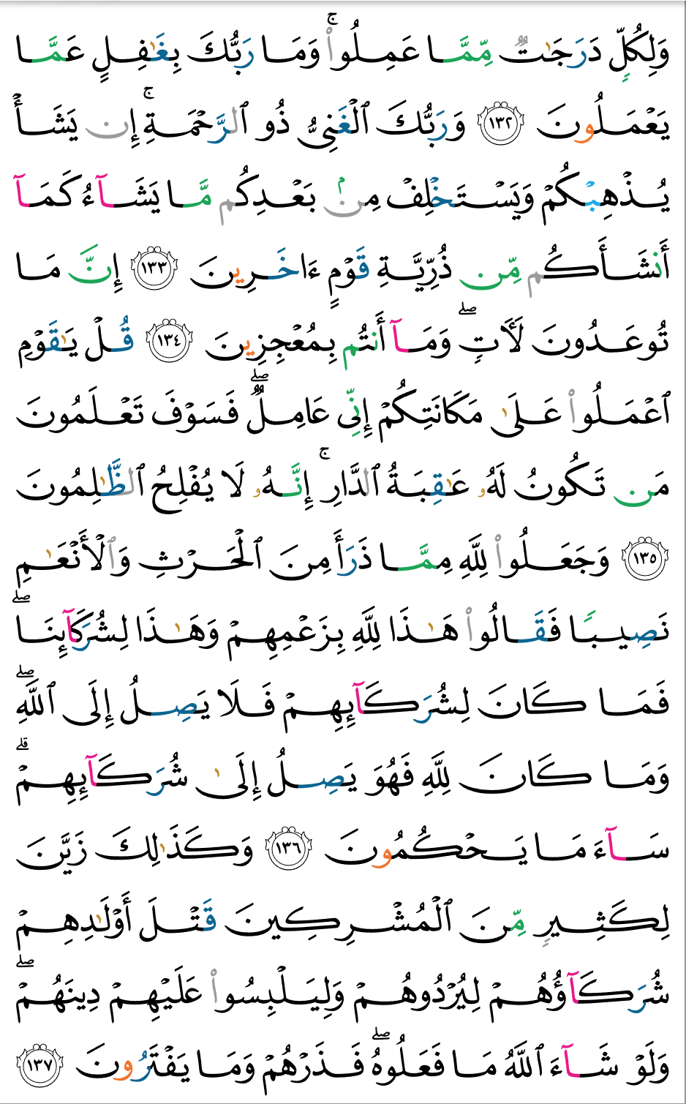
How to deal with tight lines
Change font size to eliminate overflows
Same font size for the whole Mushaf
Same font size for each page

Slide 13
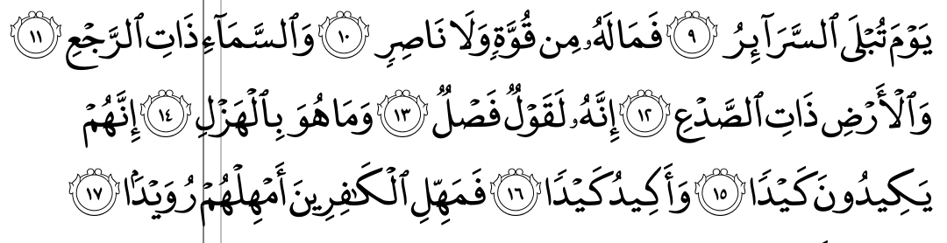
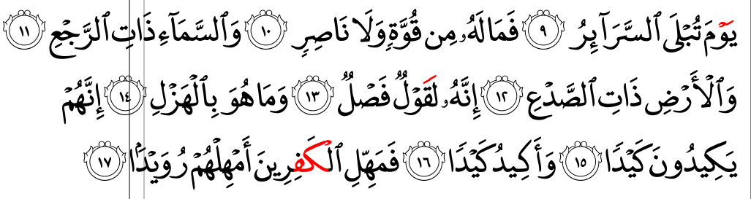
How to deal with tight lines
Add shrink rules when the line is tight
=> Deal with mark positioning to avoid collision

Slide 14
Future works Visual Metafont editor
Continue improving Visual Metafont editor => make designing fonts easier and more user-friendly
Support configuration of multiple Mushaf layouts
Add configurable axes (parameters)
View the result of OpenType rule graphically and Verify collision
Separate fonts from editor using dynamic link library
Automatic mark positioning (currently investigate force-directed techniques)

Slide 15
Links
DigitalKhatt project source code
https://github.com/DigitalKhatt
DigitalKhatt web site
https://digitalkhatt.org/about
DigitalKhatt X account
https://x.com/DigitalKhatt
Demos using front end justification
https://github.com/DigitalKhatt/digitalkhatt.org/tree/master/ClientApp/src/app/components/hbmedina

